Slide 1
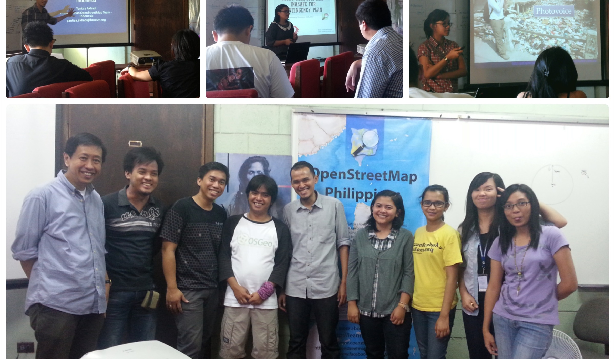
An Introduction to TeachOSM
Teaching Geography with OpenStreetMap

Slide 2
Agenda
What is TeachOSM?
Why do we need TeachOSM?
Highlights
Six Reasons to use OSM to teach geography
Summary

Slide 3
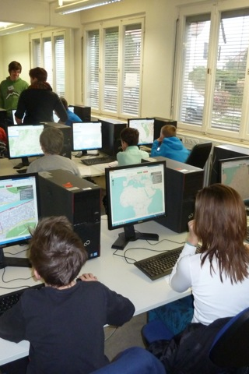
TeachOSM: A Resource for Educators
Getting Youth Involved
Photo: middle-school school students learning to map.
Credit: MaptimeSF/Lyzi Diamond

Slide 4
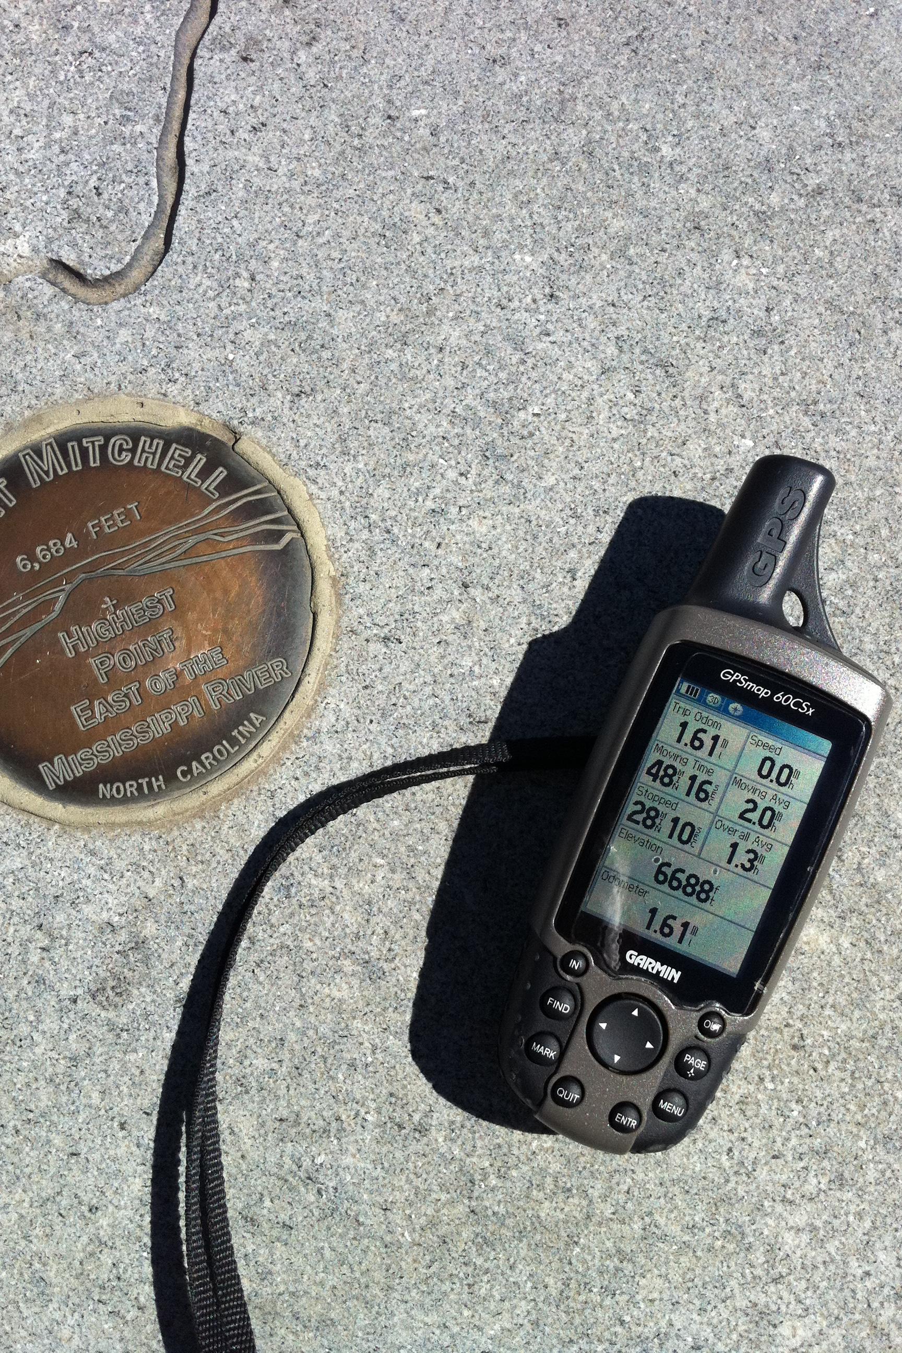
What is TeachOSM?
TeachOSM is a growing resource for educators at all levels to introduce open source mapping in their classrooms and training sessions.
TeachOSM offers modular lessons that teach basic geographic concepts through applied mapping on OpenStreetMap.
TeachOSM has resources to help instructors to identify, assign, manage and grade a mapping assignment.
Photo: Mapping peaks using GPS.
Credit: SEJohnson

Slide 5
Why do we need TeachOSM?
Provide tools for educators not found in other OSM learning materials
Demonstrate the utility of OSM to teach geo-literacy
Help students/young adults engage with the landscape
Build a pipeline of talented mappers to sustain the project
Create opportunities for meaningful citizen engagement

Slide 6
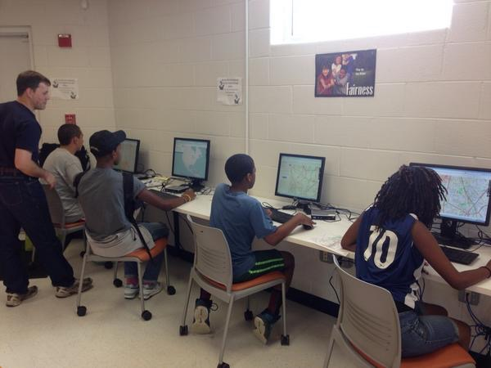
What does TeachOSM do?
Established a web site
Create repository of case studies
Planned half-day workshop for educators
Outreach to teachers, educators, youth leaders
Established micro credential initiative to award credit for service hours
Photo: middle-school school students learning to map.
Credit: SEJohnson

Slide 7

For educators…
Basic map editing skills
How to manage student accounts
Organizing & managing your mapping event
The Tasking Manager, for assigning blocks of work
Quality control, assessment, grading
Ready-made projects for teachers to adapt
Photo: Mapathon, Spring 2014.
Credit: Brian DeRocher

Slide 8
For Students…
Teach basic digital mapping skills
Provide opportunity for vocational learning
Offer service learning opportunities
Humanitarian OpenStreetMap Team (HOT)
MapGive
MissingMaps
DC Great Streets
Cultivate geo-literacy through guided mapping projects
Photo: middle-school school students learning to map.
Credit: SEJohnson

Slide 9


GeoBadges: Micro-credentials for Service Learning
A new initiative to give credentials to students and teachers for contributions to OpenStreetMap
Expectations:
Contribute to the map & foster community
Be a Resource for Peers
Develop an Understanding of Basic Digital Mapping Constructs
Contribute to Community Mapping Goals (local, HOT, MapGive, MissingMaps)
Web: http://geobadges.org/

Slide 10
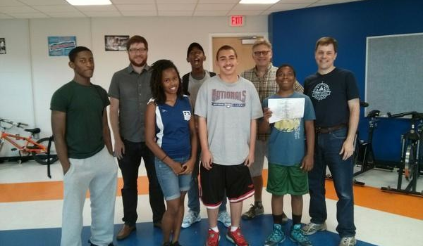
Highlight: TeachOSM and the Georgia Avenue Project
Training Young Adults to Map

Slide 11
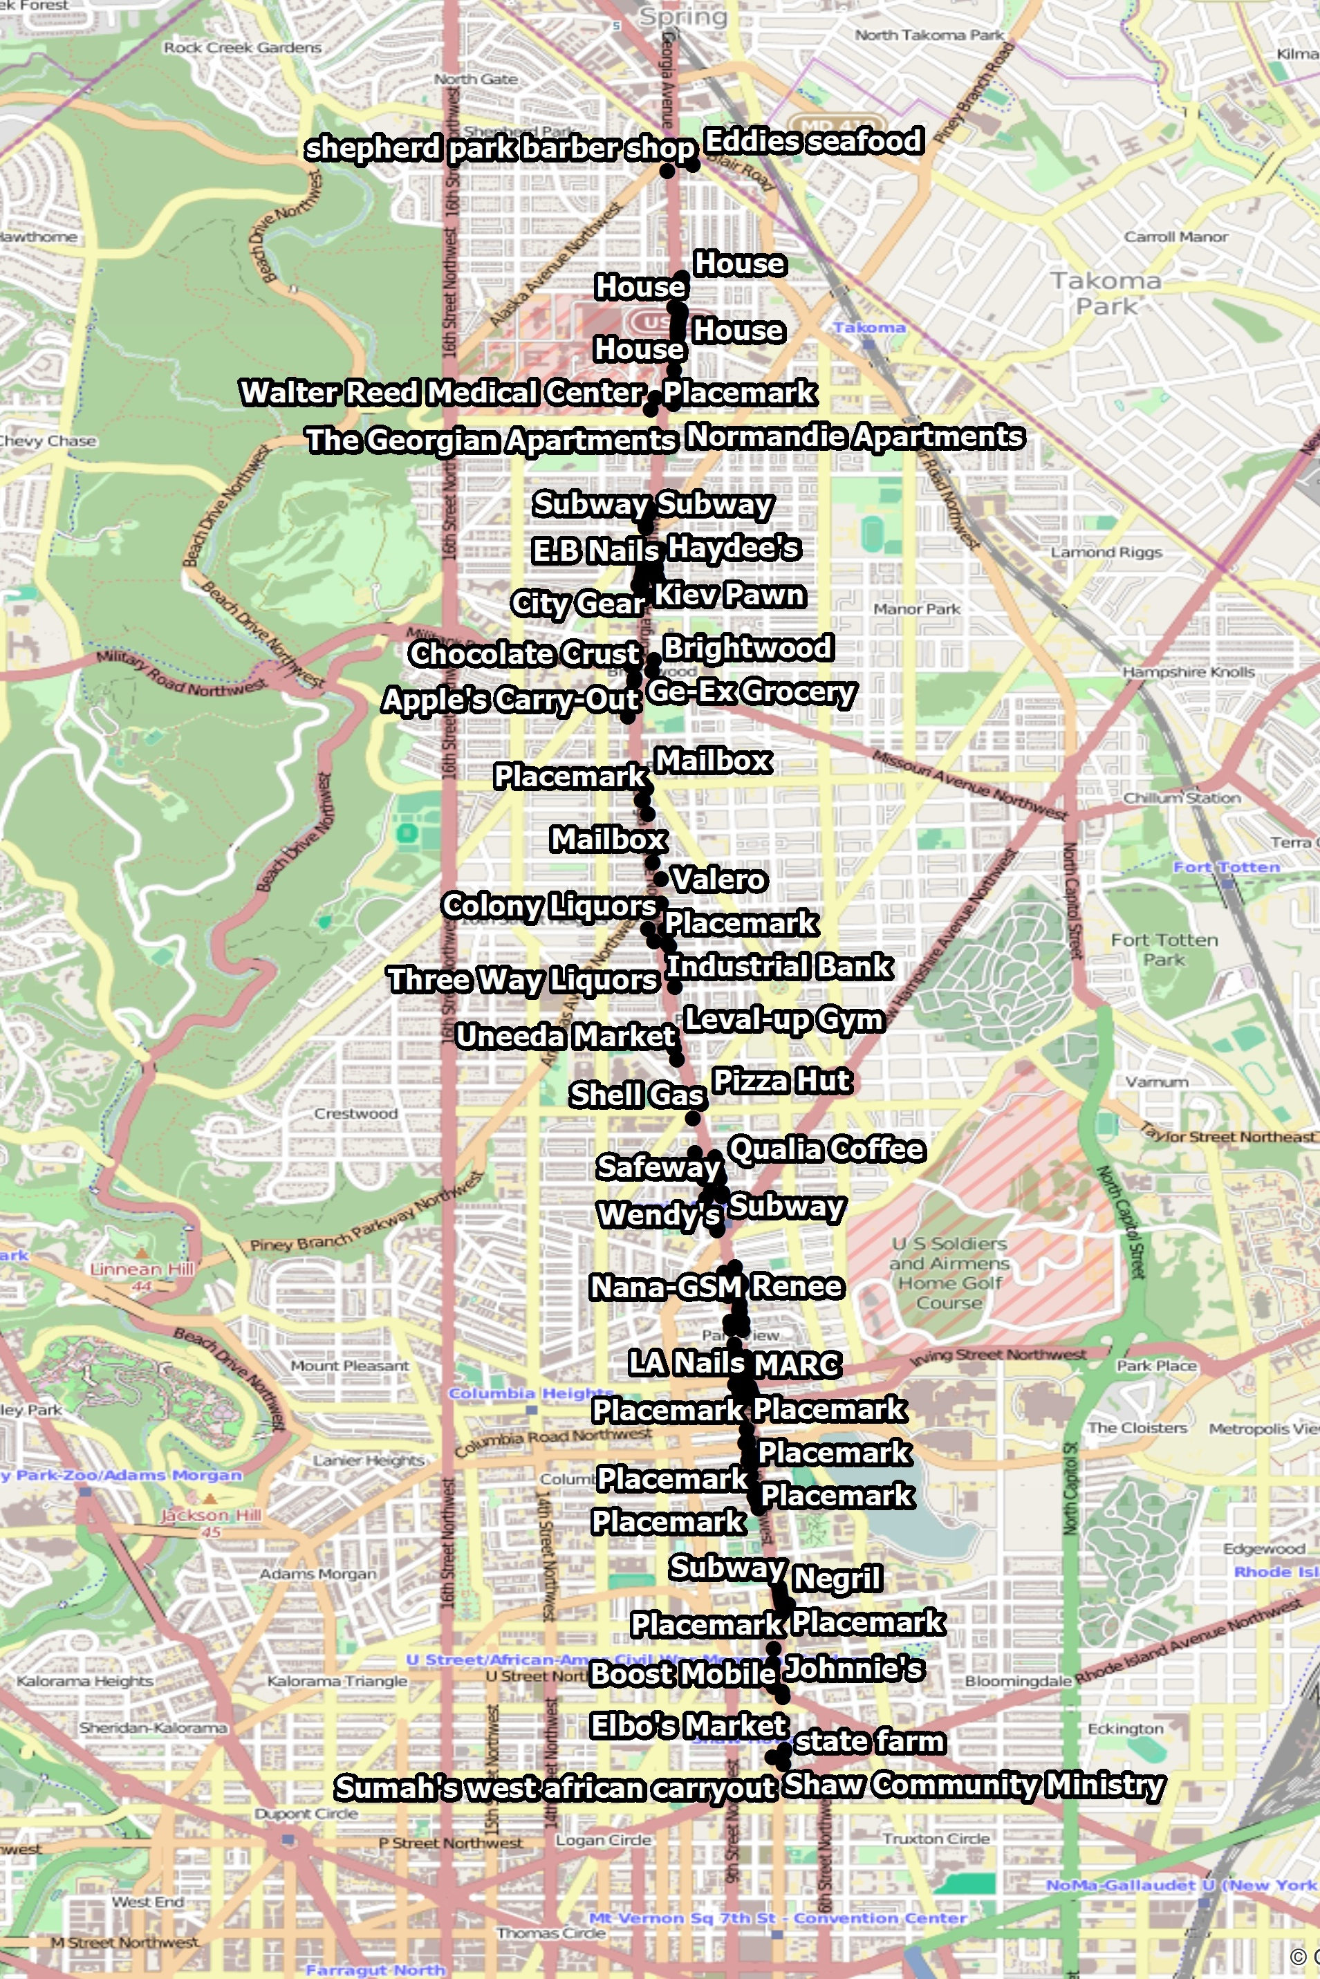
Georgia Avenue Mapping Project
Youth Ambassadors used Georgia Ave data gathered for street-level survey
We trained ~15 Youth Ambassadors in how to edit in OpenStreetMap
Results:
Over 270 features added to the OpenStreetMap
Survey data visible on the map!
http://wiki.openstreetmap.org/wiki/Georgia_Avenue_Youth_Ambassadors_Mapping_Project

Slide 12
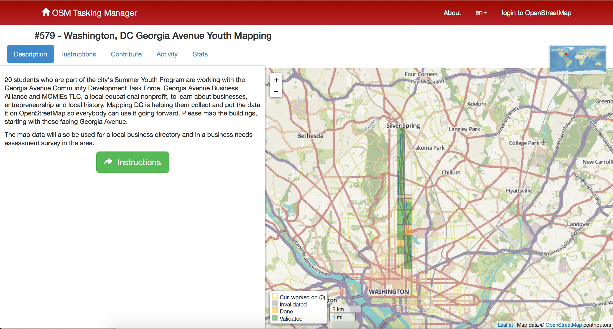
Using the OSM Tasking Manager to control workflow

Slide 13
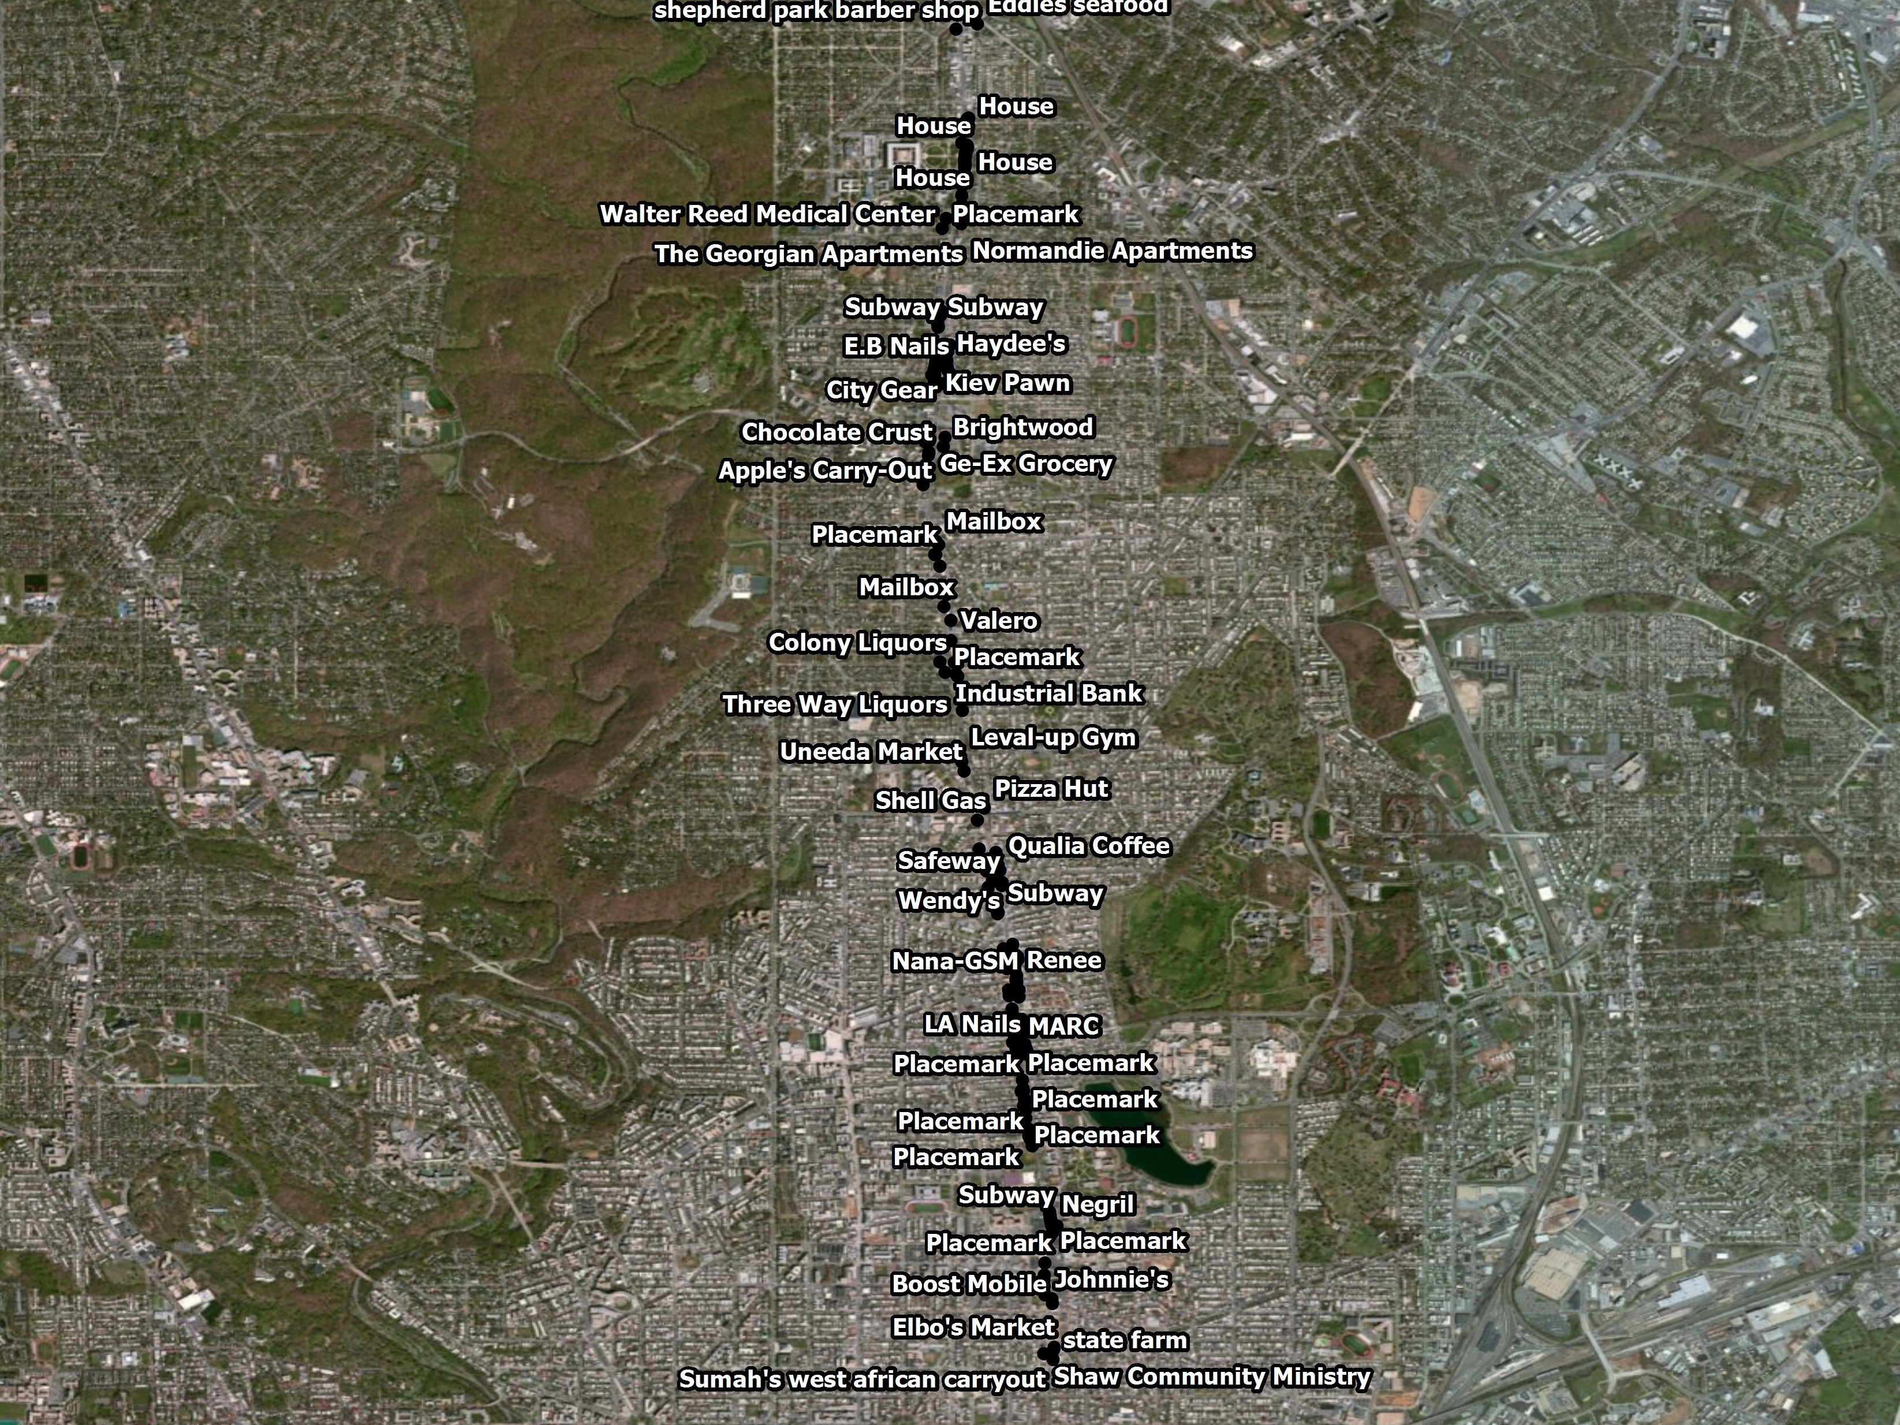

Slide 14
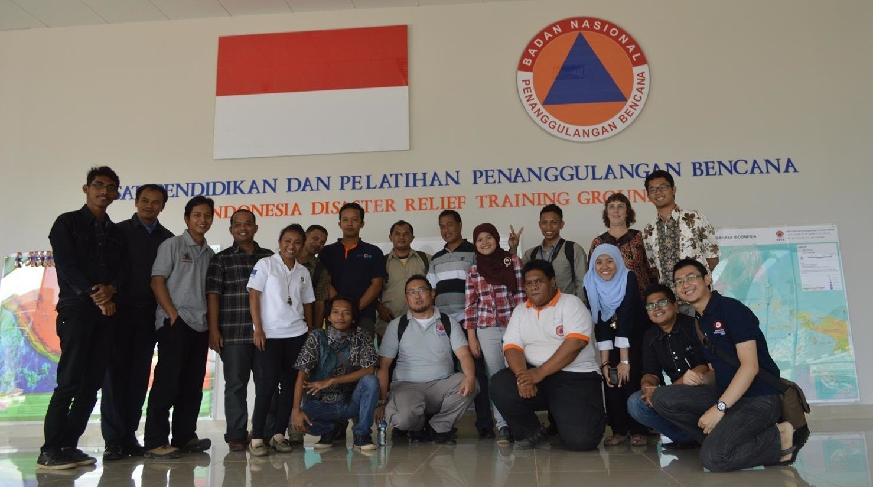
Highlight: HOT Indonesia
University Outreach Program

Slide 15
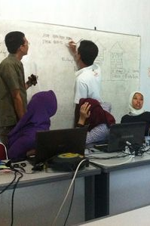
University Outreach & Contingency Planning
Focus is disaster preparedness and contingency planning for vulnerable areas
Working with local communities to identify & map exposure and risk
Using QGIS & InaSAFE plugin for downstream analysis
Over 4 years, conducted 86 trainings, 2300 people trained, ~2m buildings, ~14500 schools

Slide 16
Why TeachOSM?
Reasons to Use OpenStreetMap to Teach Geography

Slide 17
OpenStreetMap Gives Students Immediate Experience
Direct Learning - Young adults gain direct experience of space, place, and location
Geography at a 1:1 Scale
The terrain is the map
Nurture and understanding of how to read the landscape

Slide 18
OpenStreetMap Reinforces Social & Historical Literacy
Provides meaningful engagement for children that can broaden academic & career options
History-shaping events often happen at certain places for geographic reasons.
Contributing to OSM, -through site surveys, editing, & meeting other citizens, helps us understand geographic processes that underpin social events.

Slide 19
OpenStreetMap Supports Collaborative Learning
Mapathons help students establish positive relationships with other mappers in the community
Collaborate with your fellow citizens to record features of interest
Share observations about your community
Give visibility to community landmarks

Slide 20
OpenStreetMap Provides Opportunities for Service-based Learning
Opportunities to engage in ongoing community service projects & service learning engagements
Contribute to humanitarian relief efforts through Humanitarian OpenStreetMap Team
Use MapRoulette ‘micro-tasking’ to help improve map quality
Give young adults a meaningful stake in maintaining map data in their neighborhood

Slide 21
OpenStreetMap Supports Self-directed Learning
The open platform encourages self-guided learning and allows students to challenge themselves.
Mapping projects encourage collaboration & teamwork
Students learn how to think critically about geographic features and how to model their world.
Active mapping nurtures the young adult’s natural inquiries into the world.

Slide 22
OpenStreetMap Requires No Special Resources
No software required - works in the browser
No permission required - OSM is a do-acracy: DO IT!
Data are free and can be exported for downstream use in desktop GIS packages (e.g. QGIS, ArcGIS)
No fees, licensing charges, royalties, paywalls, subscriptions, etc.

Slide 23
Sample Ideas for Projects
Conduct a street survey in your neighborhood:
http://teachosm.org/en/cases/DCGreatStreets_survey_casestudy/
Map for disaster relief/preparedness:
http://mapgive.state.gov and http://missingmaps.org/
Add historical features to OpenHistoricalMap:
http://ow.ly/MfhZw
Map local food resources:
http://teachosm.org/en/cases/farmers-market/
Start a student mapping society:
https://www.facebook.com/GWHMS

Slide 24
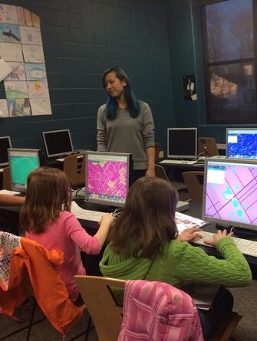
Getting Involved
Where do I get started?
Subscribe to the TeachOSM mailing list
Send an inquiry to info@teachosm.org
How do I contribute?
Draft a case study for the web site (http://teachosm.org)
Help refine our materials
Photo: middle-school school students learning to map.
Credit: MaptimeSF/Lyzi Diamond

Slide 25
Summary
As an open freely editable map of the world, OpenStreetMap is an excellent platform for teaching geography
OpenStreetMap offers students geo-literacy, social engagement, service learning, and independent learning opportunities.
OpenStreetMap is free and requires no special equipment
Use TeachOSM and help us make it better

Slide 26

Thank You!
Steven Johnson, Principal
Geomantic Labs
sejohnson8@gmail.com
@geomantic
geomantic
The entirety of this document is licensed under Creative Commons CC-by-SA-2.0 share-alike license: https://creativecommons.org/licenses/by-sa/2.0/
Maggie Cawley, Founder
Boomerang Geospatial
maggie@boomgeo.com
@maggiemaps
mcawley

